Slide 1

Neuroprotective role of Anti-cancerous compounds against ROCK 2 protein: an in-silico study
Major Project Presentation Group 07
Submitted By: Submitted to:
Tirtharaj Datta (2019537381) Dr.Niraj Kr Jha
Afan Ahmed(2019007969) SUSET Asistant Professor

Slide 2
Problem Statements
What is neurodegeneration?
Which disease is to be chosen for our study?
What is the role of ROCK2 protein in NDD’s?
What class of flavanoids to be chosen for the study?

Slide 3
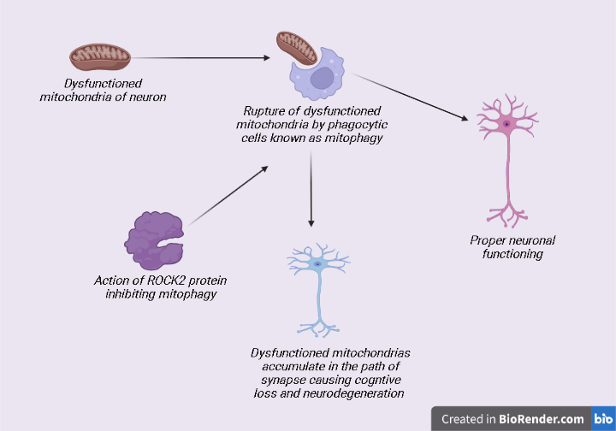
Mode of action of ROCK 2 protein

Slide 4
Aim
To compare Anti-cancerous potential of flavanoids against ROCK 2 protein to manage NDD’s

Slide 5
Objectives
Structure analysis of ROCK 2 protein and anti-cancerous compounds
Perform molecular docking analysis of complex to check the efficacy of compounds
Molecular binding analysis
To validate the resultant compound in-vitro and prove the results.

Slide 6
Literature Survey
There are 6 different classes of flavanoids as follows:
Isoflavanoids
Flavanones
Flavanols
Flavonols
Flavones
Anthocyanidins

Slide 7
List of Anticancerous Flavanoids
Cancer Incidence depends upon following four factors : Oxidative stress, Apoptosis, Genetic mutations, mutagens. (1)
Out of the following factors it is seen that flavonoids act as anticancerous agents targeting Oxidative stress(2) and apoptosis.(3)

Slide 8
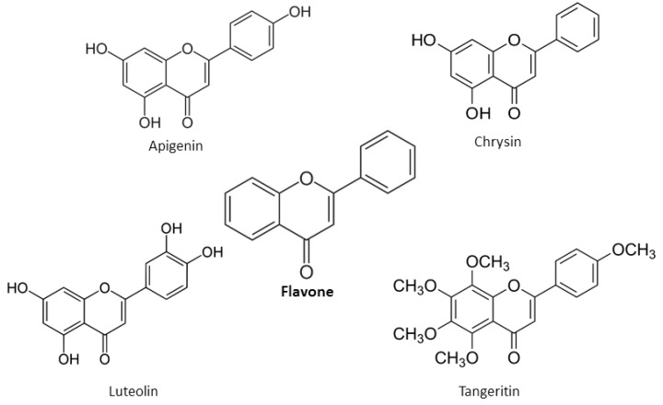
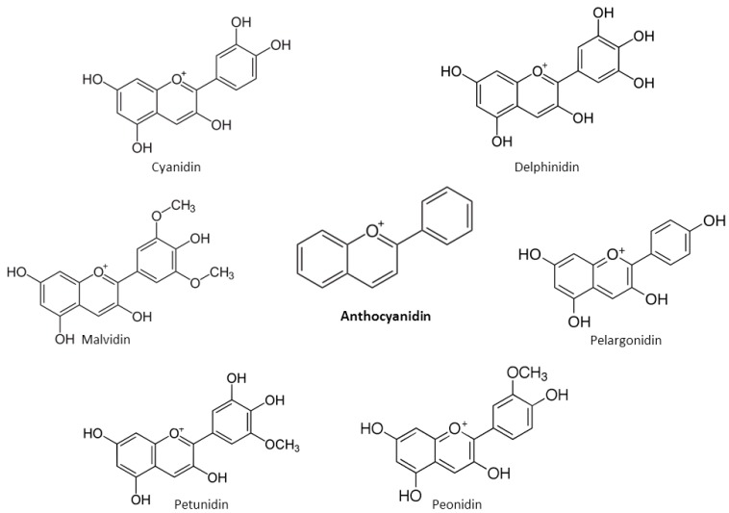
List of compounds chosen for Molecular Docking

Slide 9
Flavanoids for Neuroprotection (Literature search)
The flavonoid isoquercitrin promotes neurite elongation by reducing RhoA activity (4)
Compound Reserveterol has been used for ROCK 2 inhibition as a futuristic approach for treating Alzheimer’s Disease.(5)

Slide 10
Project Update
Retreived Structure of ROCK2 protein (Uniprot id: 4L6Q)
Macromolecule (PDBQT) generated for target protein for docking using AutoDock Vina1.77.
Target compounds are obtained by utilizing PubChem and converted in to the PDBQT format (library generation ) using OpenBabel.
Active site and Binding site are obtained through CastP for ROCK2 protein.
x,y,z co-ordinates obtained and validated

Slide 11
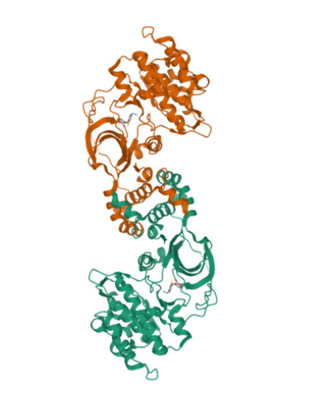
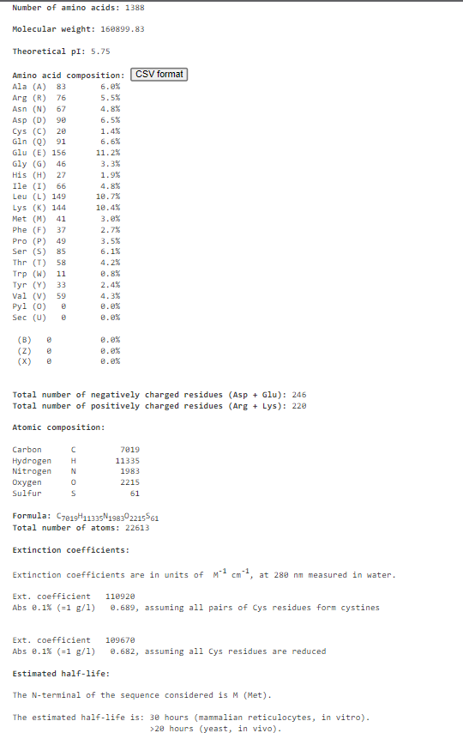
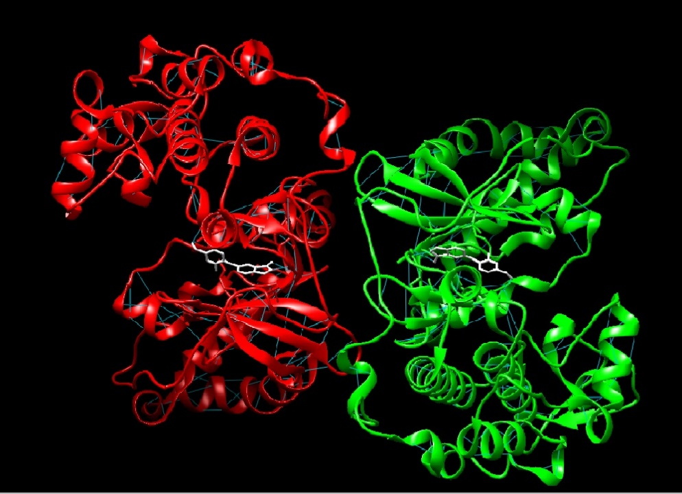

Uniprot Structure (4l6Q)
protParam Database
Ligand : 1WU (Visualization in the UCSF CHIMERA)

Slide 12
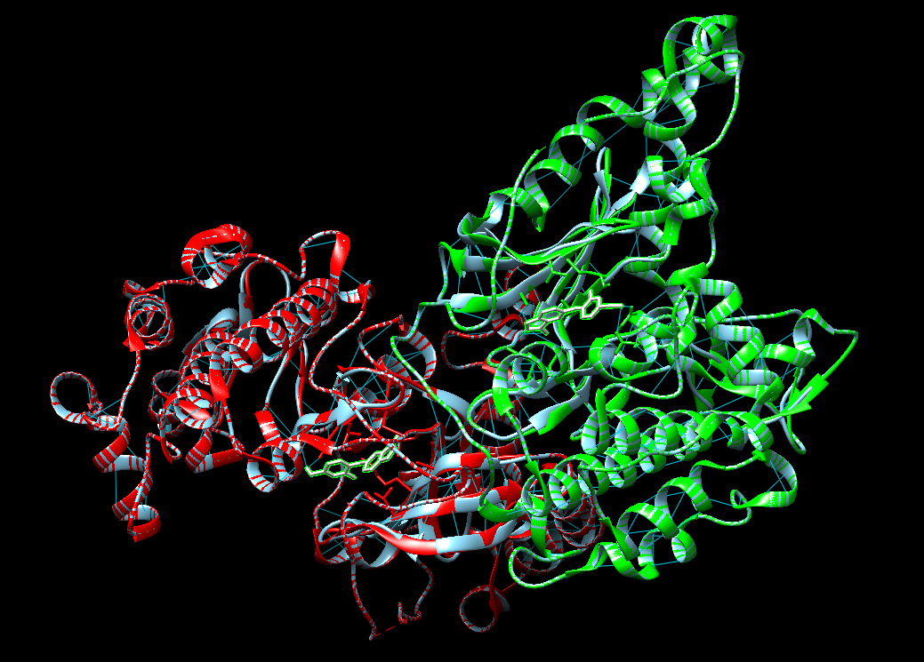
A Chain
B Chain
Ligand
Macromolecule (AutoDock Vina )

Slide 13
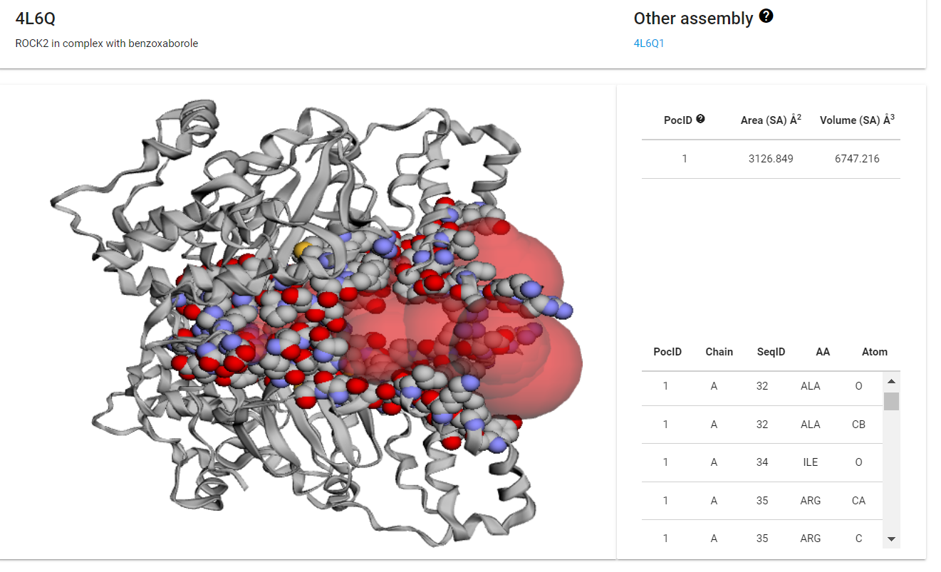
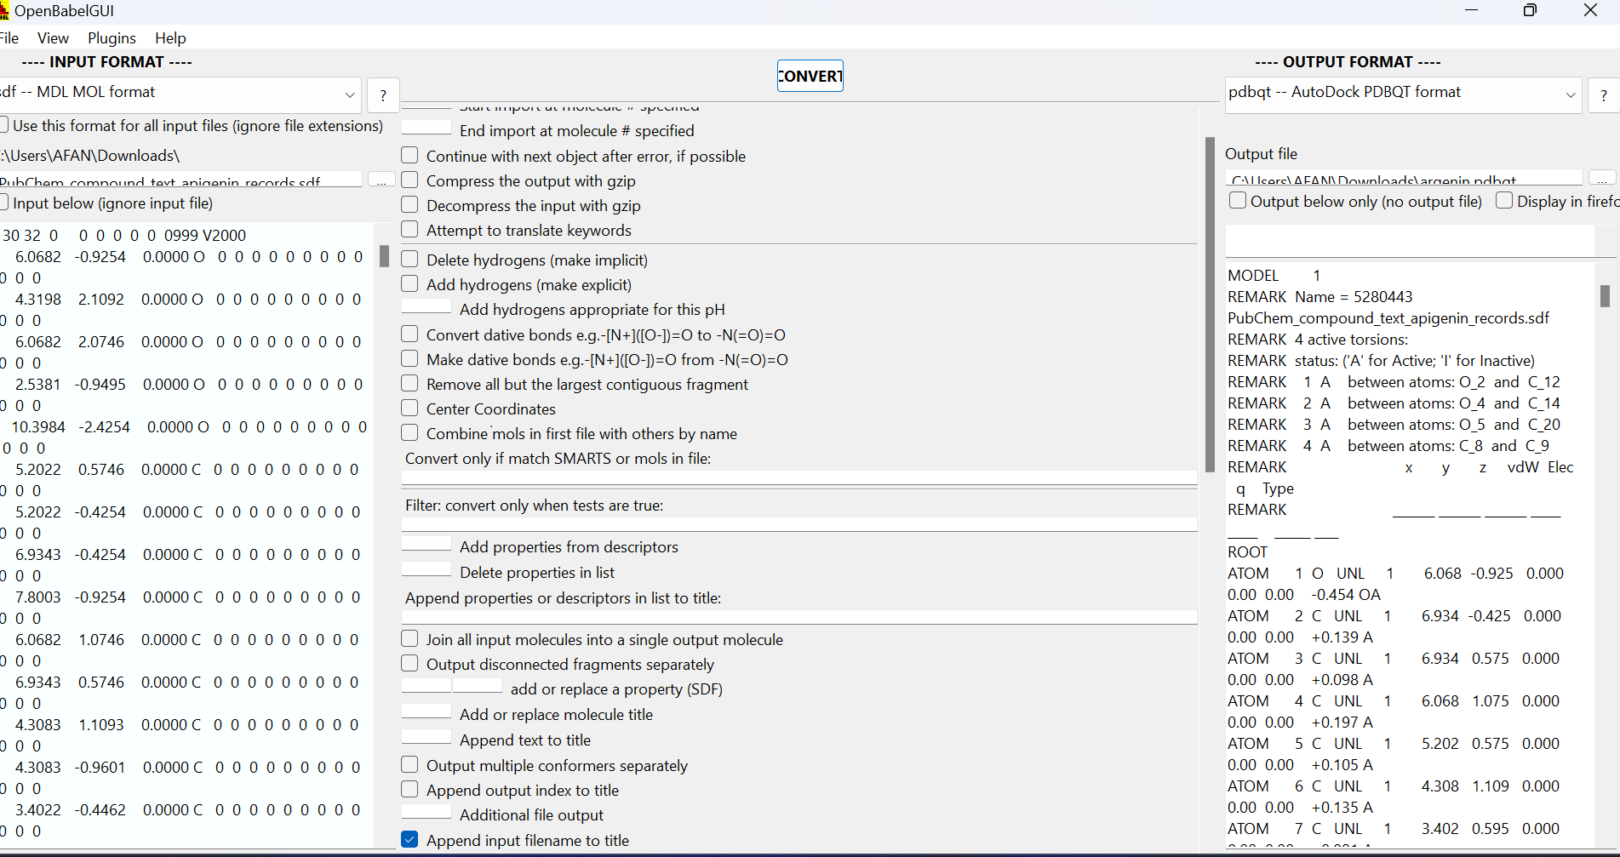
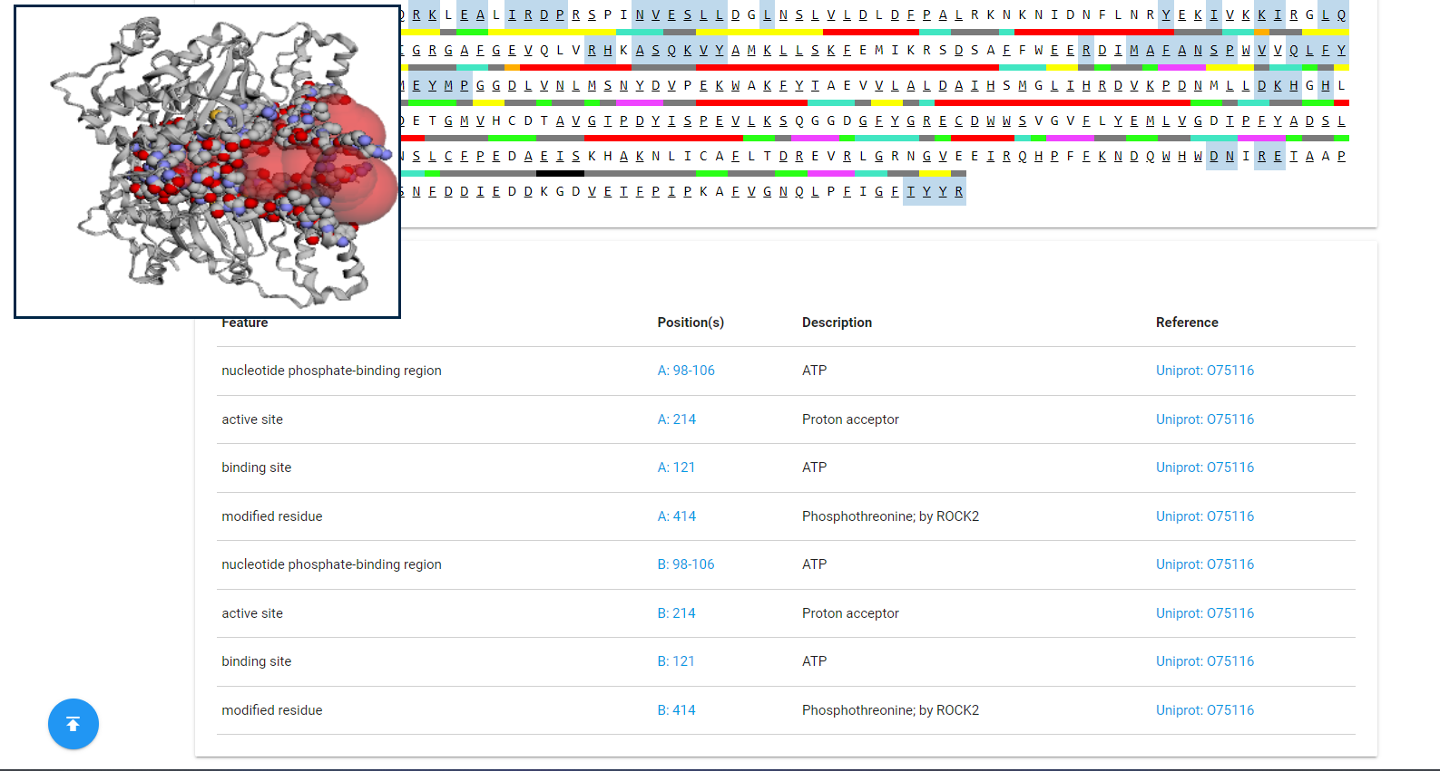






OpenBabel

Slide 14
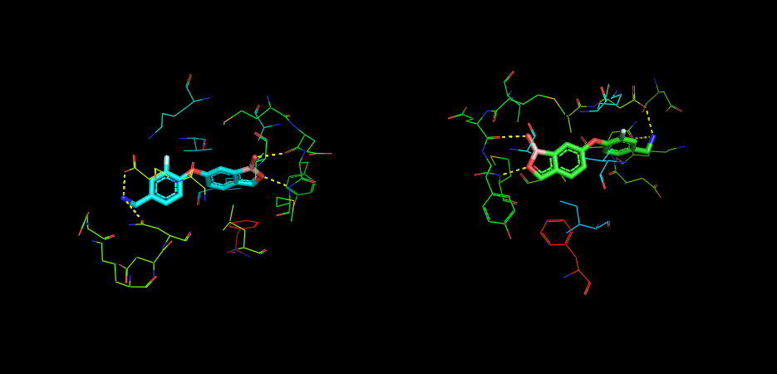
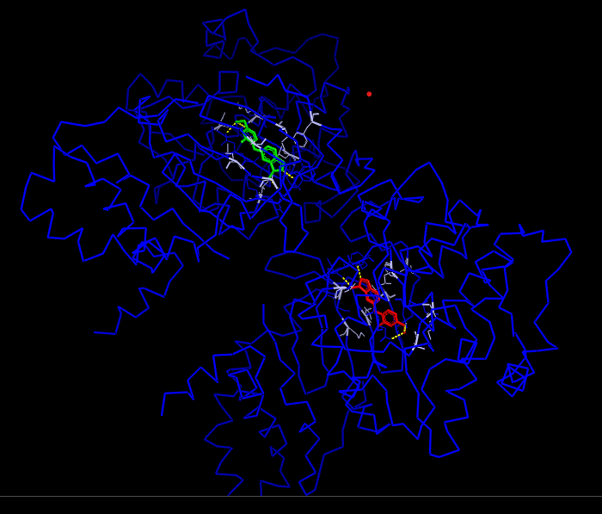
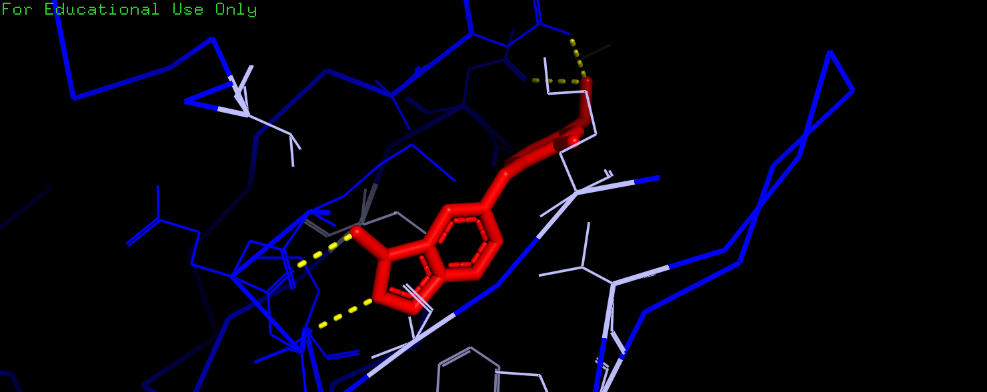
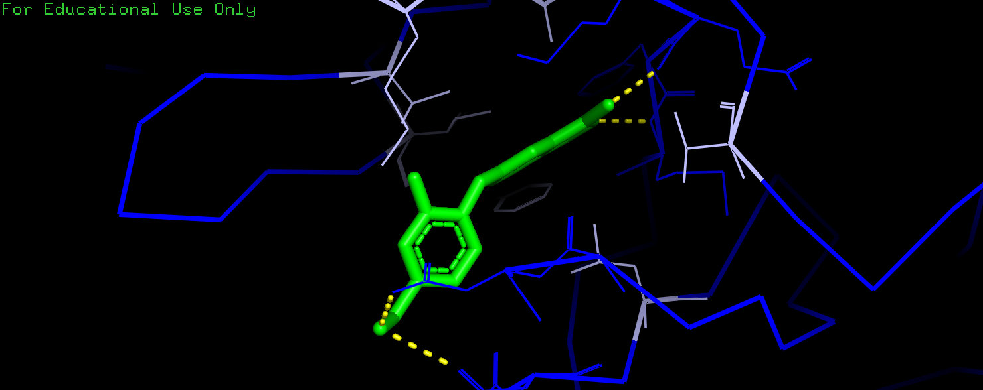
Regions prediction
Active site regions
Chain A
Chain B

Slide 15
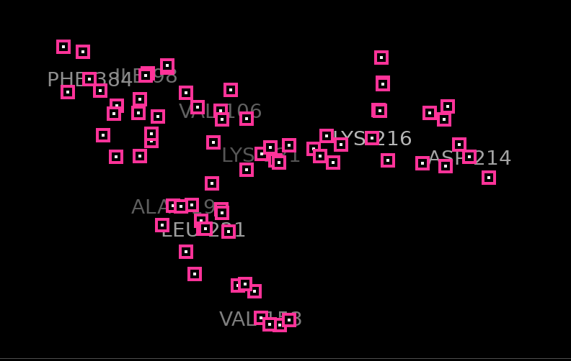
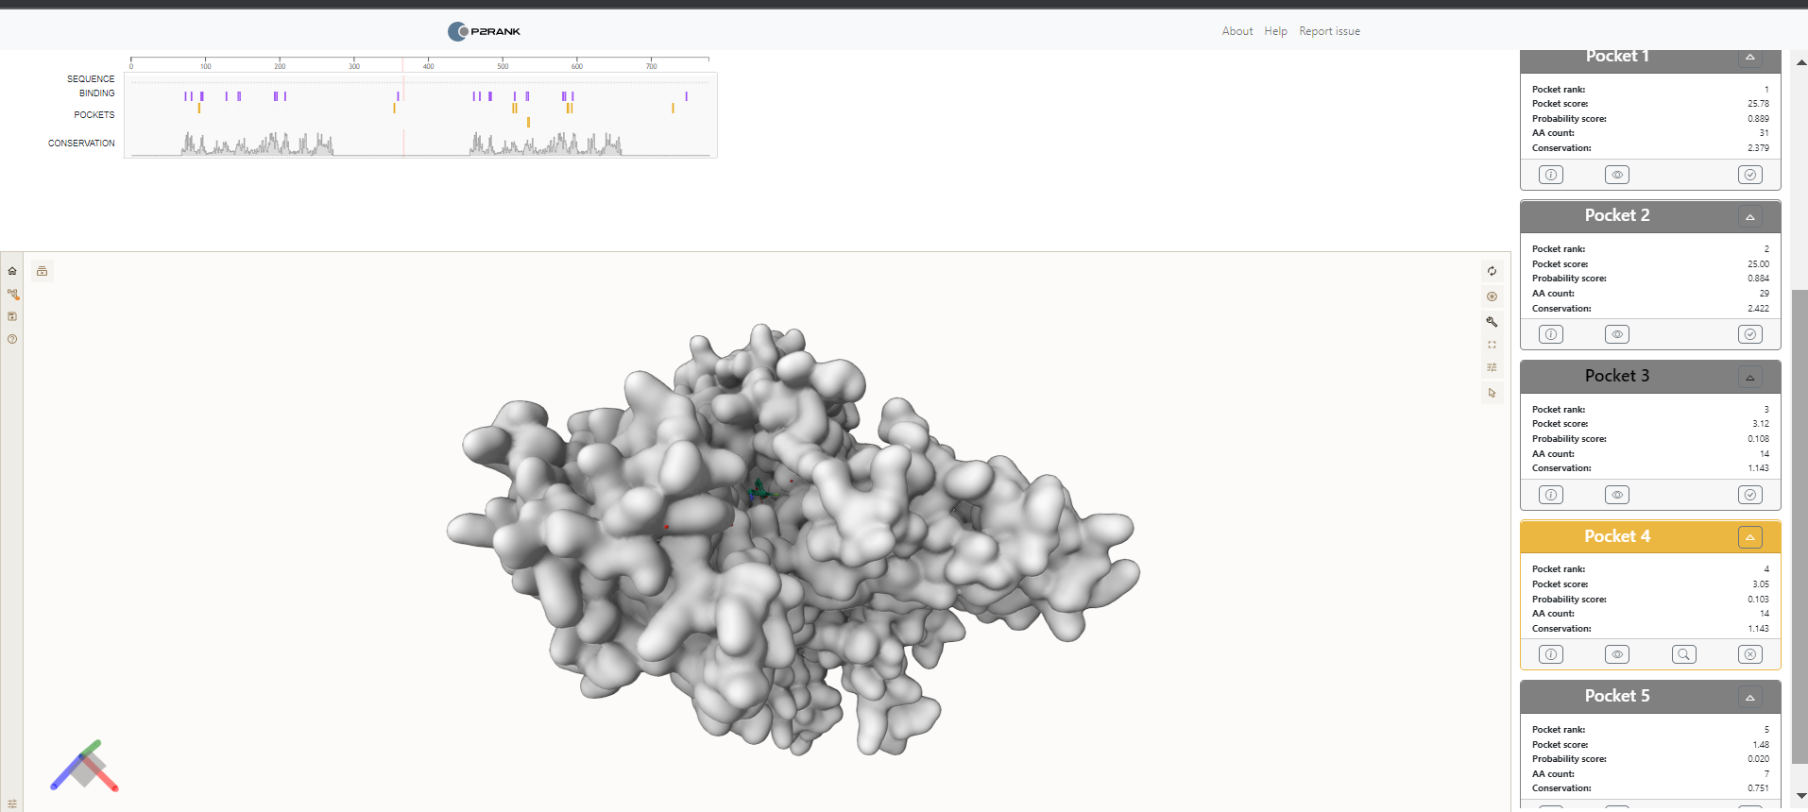
Active site residues
Pocket size validation

Slide 16
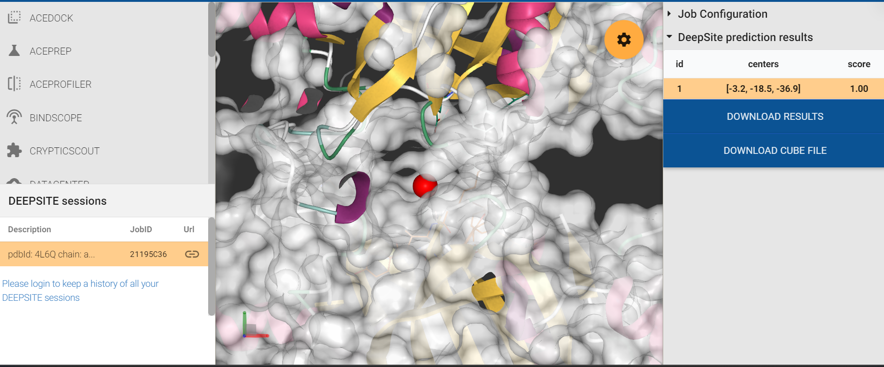
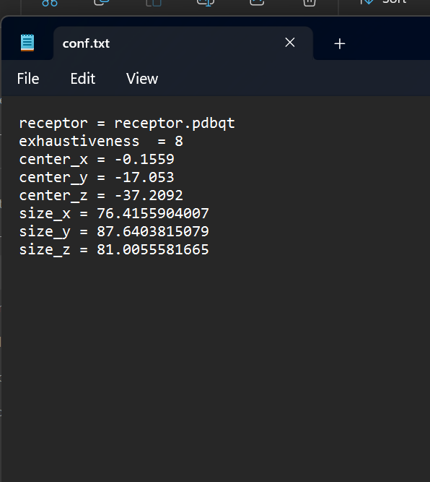
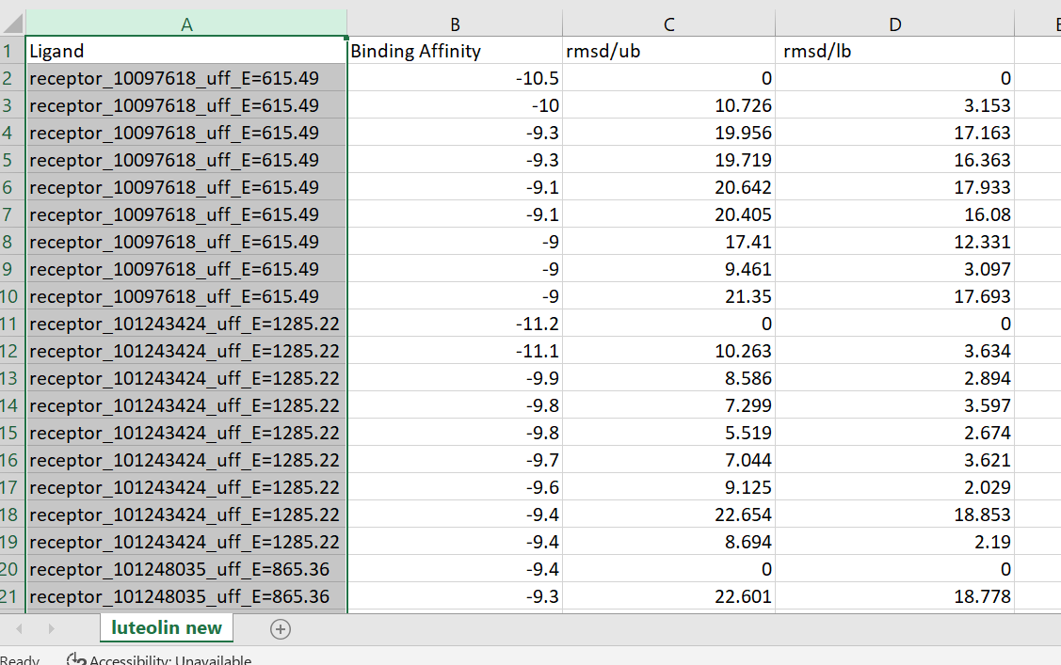
Docking result of luteolin and validation

Slide 17
References
Palazzolo, G., Horvath, P., & Zenobi-Wong, M. (2012). The flavonoid isoquercitrin promotes neurite elongation by reducing RhoA activity. PloS one, 7(11), e49979. https://doi.org/10.1371/journal.pone.0049979
Mani, S., Jindal, D., Chopra, H., Jha, S. K., Singh, S. K., Ashraf, G. M., Kamal, M., Iqbal, D., Chellappan, D. K., Dey, A., Dewanjee, S., Singh, K. K., Ojha, S., Singh, I., Gautam, R. K., & Jha, N. K. (2022). ROCK2 inhibition: A futuristic approach for the management of Alzheimer's disease. Neuroscience and biobehavioral reviews, 142, 104871. https://doi.org/10.1016/j.neubiorev.2022.104871

